Slide 1
LLM-A*: Large Language Model Enhanced Incremental Heuristic
Search on Path Planning
Silin Meng, et.al
Conference on Empirical Methods in Natural Language Processing(EMNLP),2024
Shriman Raghav Srinivasan
Inspired by the LLM-A* research paper, I built a hybrid path planning system that combines traditional A* search with a locally-running Mistral 7B language model. I developed an interactive simulation environment with side-by-side visualization that clearly demonstrates how my implementation reduces node exploration by 50-70% while maintaining path quality. My approach focused on robust waypoint validation to handle potential LLM hallucinations and remove waypoints those were redundant.

Slide 2
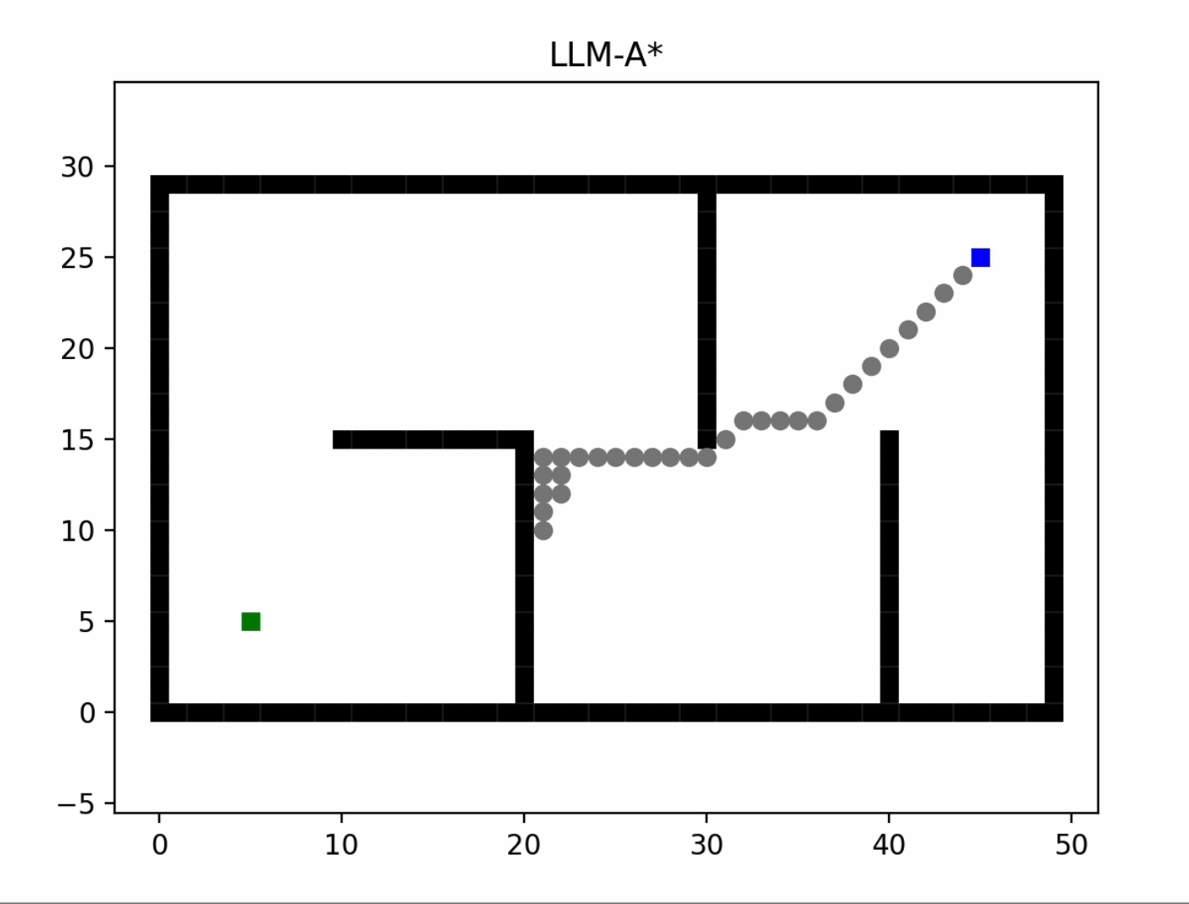
Objective
Develop a hybrid path planning system combining classical A* with Large Language Model (LLM) guidance
Utilize cost-aware LLM-generated waypoints to reduce node expansions in complex environments
Preserve path validity and near-optimality using segment-wise A* planning and fallback
Implement structured prompt engineering to ensure parse-able and robust waypoint output
Visualize A* and LLM-A* plans through side-by-side robot simulations for direct comparison

Slide 3

LLM-A*Implementation What , How& Why?
WHAT
WHY
LLM-A* is a hybrid path planning algorithm that leverages LLM-generated intermediate waypoints to guide A* search and reduce computational overhead in grid-based environments.
Reduces node expansion via segment-wise planning
Enables semantic reasoning over barriers and cost
Cost-aware prompting improves efficiency in large maps
Makes classical A* smarter with global guidance from local LLM
HOW
Input-Binary Occupancy Grid
Environment Encoding - (Start, Goal)
LLM interfacing through Ollama
Cost aware RePE Prompting
Waypoints Generation & Filtering
Output-Path Generation
This implementation uses Mistral AI –7B running locally and accessed through Ollama's REST API.
The entire pipeline is written in Python and integrates Matplotlib for animation and visualization.

Slide 4
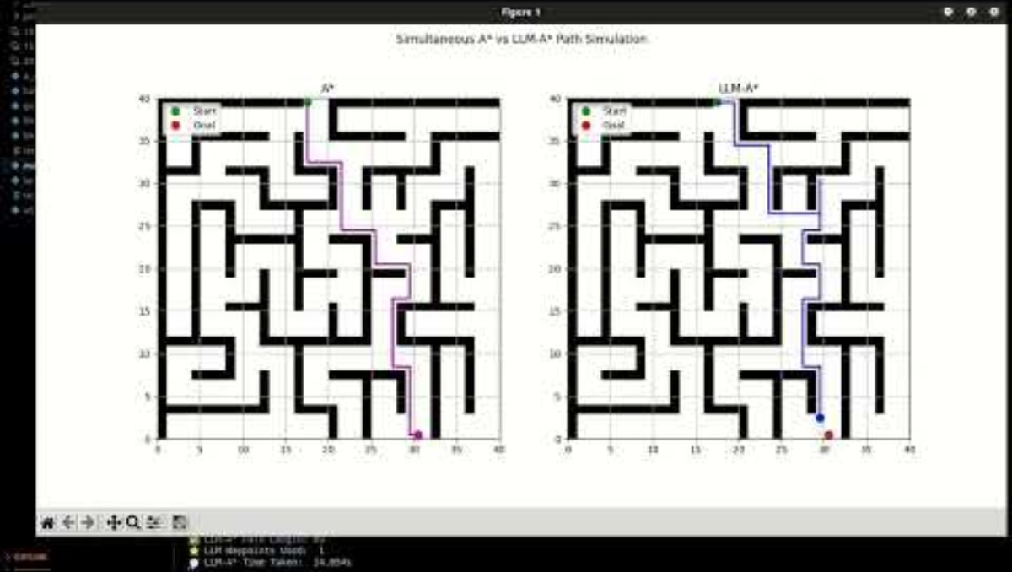
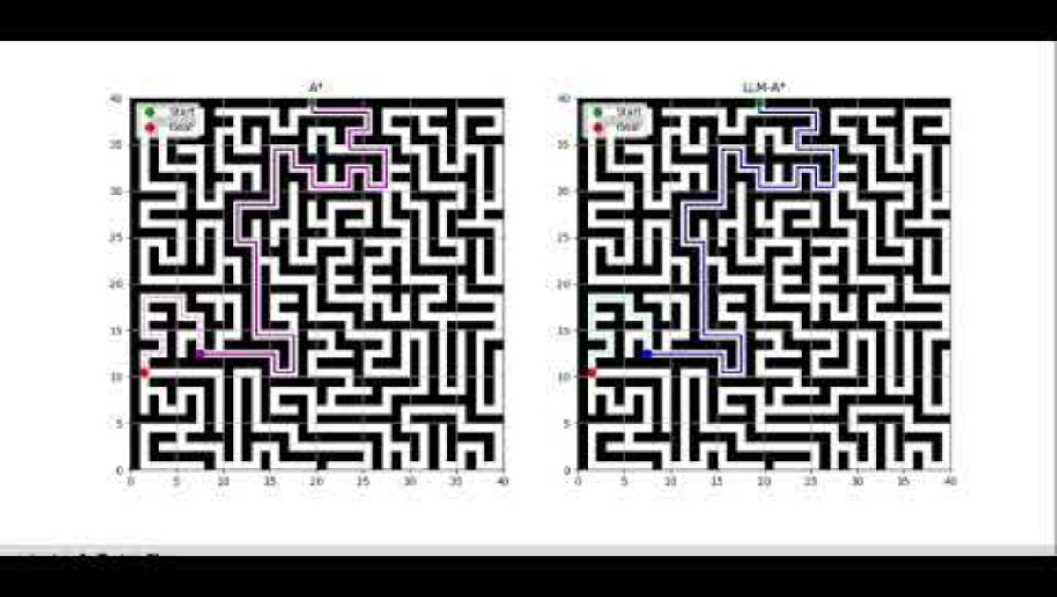
Results
15 X15 Maze environment Simulation-Nodes : 192 vs 156
Features | Original Paper | My Implementation
Model | GPT-3.5, LLaMA3-8B | Mistral 7B
Scale | Up to 50x30 simple 2D environments | Up to 20 x 20 Complex maze environments
Prompting | Few-shot, RePE | Cost-aware RePE-style
Filtering | Not Available | In-bounds, obstacle-aware, redundant pruning
Fallbacks | Full path fallback | Segment-wise A* fallback
Visualization | Static plots only | Full 2D Simulation
Evaluation | Op count, length, success rate | Explored nodes, path length, visual comparison
Exploration Efficiency | Not Analyzed | 20% Avg node reduction
20 X 20 Maze environment Simulation-Nodes : 706 vs 554
Future Steps...
Training custom LLM with better planning
Extension to real environments. (VLM's)
Gazebo/Issac Sim implementation with ROS2 ( In works)

